Slide 1




Shield Insurance Business Insights
Shield Insurance is a leading provider of comprehensive insurance. solutions, serving businesses and individuals of all Age Groups with tailored coverage and exceptional customer service.
By Ashutosh Jha

Slide 2








Contents
About Shield Insurance Company
1
2
Objective
Shield Insurance aims to leverage data analysis to gain valuable insights into
their customer base, revenue generation, and business performance.
Data set, Data Model & Dashboard
3
Used Power BI Intelligence tool to
analyse the given data set , data
modelling and creation of Dashboards.
4
Key Insights
These objectives involves gathering critical insights to inform strategic
decisions and business growth for Shield Insurance.

Slide 3



About Shield Insurance
Shield Insurance is fictional insurance company. This
company was founded with a vision to become a trusted partner for our clients, providing innovative insurance
solutions that protect their assets and ensure their financial security.
Shield Insurance has sales offices in major cities such as
Delhi NCR, Indore, Chennai, Mumbai and Hyderabad. A diverse set of policies, catering to customer’s demands via online platforms such as websites and applications, as well as offline channel agents and direct services.

Slide 4








Objective
1
Analyze Customer Base and Revenue Generation
Identifying the total number of customers and tracking total revenue generated.
Monitoring customer growth rate and revenue growth rate on a daily basis.
2
Policy Changes Monitoring
Analysing changes in policies on a month-over-month basis to identify trends and areas for improvement.
3
Trend Analysis Over Time
4
Sales Mode and Age Groups Analysis
Analysing customer demographics by sales mode to understand
customer preferences and behaviours.
Assessing the impact of age groups on expected settlements, sales mode
preferences, and policy choices.
Developing visualizations to analyse trends in customer and revenue growth over time.

Slide 5

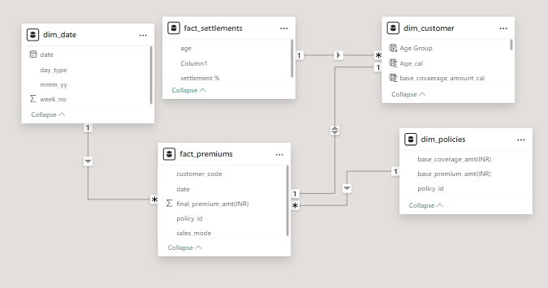

Dataset and Data Modeling
Brief on Dataset
•
Data is available in csv format from November 2022 to April 2023. There are two fact tables
and four-dimension tables.
There were some common
columns in each table
which were used to create
a data model.
•
•

Slide 6


Dashboard Interaction
Microsoft Power Bi

Slide 7
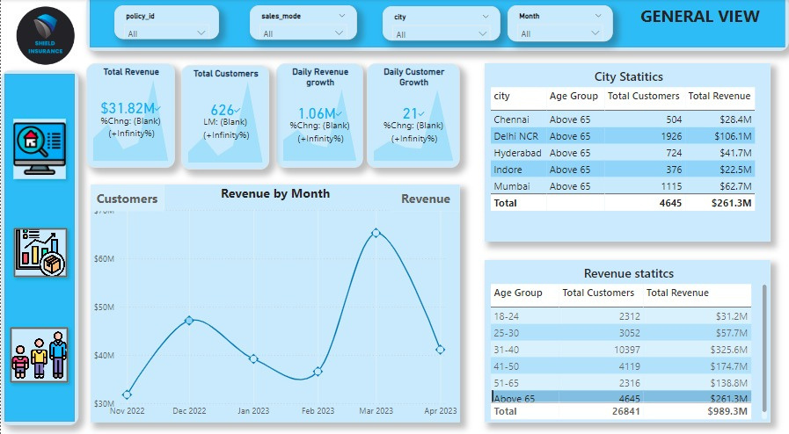

General Overview
Insights
March 23 was the highest
Revenue Generating and highest
•customer acquisition month.
People in age group of 31-40
•
were the highest contributor for
March month in both revenue
generation & customer
•
onboarding.
As march is a financial year
closing month , so Tax
harvesting & Tax saving is a
major factor of sudden rise in
revenue & customer acquisition.
Overall in 6 months Delhi NCR
led in revenue and customer
acquisition with total revenue
inr 4.86 M and 1643 customers.
•

Slide 8
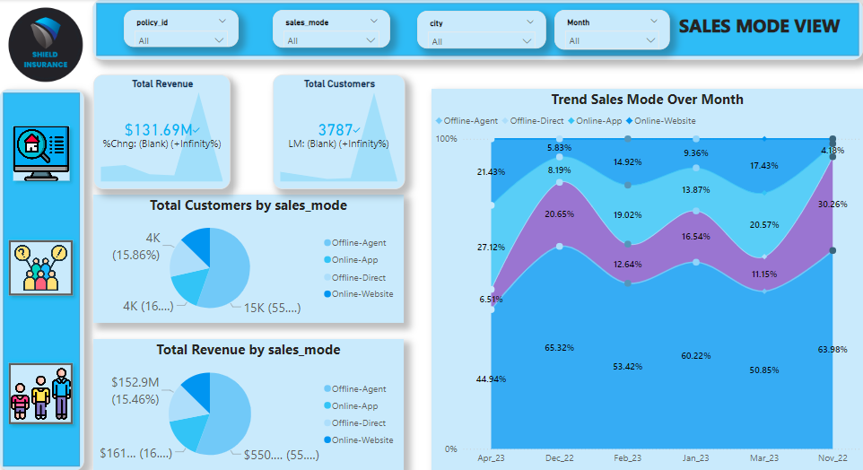

Sales Mode Analysis
Insights
•
Offline Agent contributes the
most around 55% in both
• •
revenue generation and
customer acquisition.
Business on online platform has
Offline direct and offline agent
seen a rise from Feb 2023.
is in down trend.
Overall trend of online website
•
& Online application is in
uptrend.

Slide 9
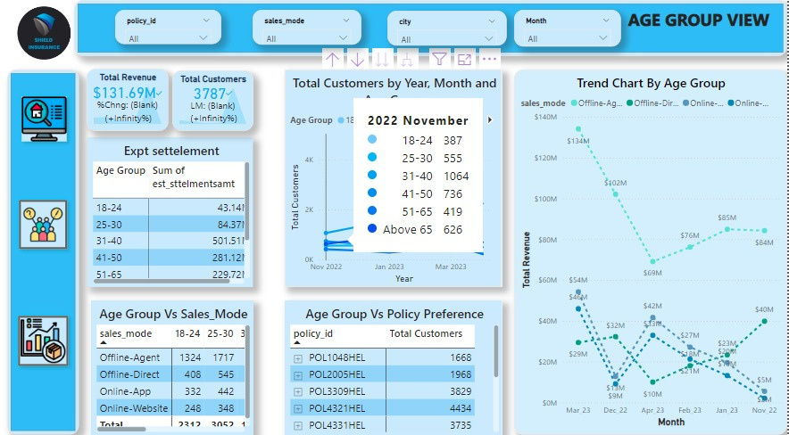
Age Group Analysis
Insights
The policy ID "POL4321HEL" has
•
4,434 customers. A big number
of customers have picked this
•
specific
policy
because
its
premium is only 5000 INR.
•
Across all plans, the 31-40 age
group was the most regular
customer base and highest revenue base. The Expected Settlement % is roughly 74% for those aged 65
and older, and around 37% for
those aged 18 to 24.

Slide 10

Future Outlook and Growth Strategies
1. Focus on Online Platform
Expand Online Presence:
Invest in digital marketing, SEO, and mobile app development to enhance user experience and increase traffic.
2.Targeted marketing
31-40 Age Group:
Develop marketing campaigns tailored to the 31-40 age group, leveraging insights to maximize acquisition and engagement.
3. Enhance Offline Agent Performance
Agent Training:
Invest in training and tools to optimize offline agents' sales performance.
4.Product Innovation
Customizable Plans:
Innovate with customizable plans and bundled offerings to meet evolving customer demands.
5.Data Drriven Descision Making
Invest in Analytics:
Use data analytics and predictive tools to understand customer behavior and tailor offerings accordingly.

Slide 11


Thank You!

